Slide 1
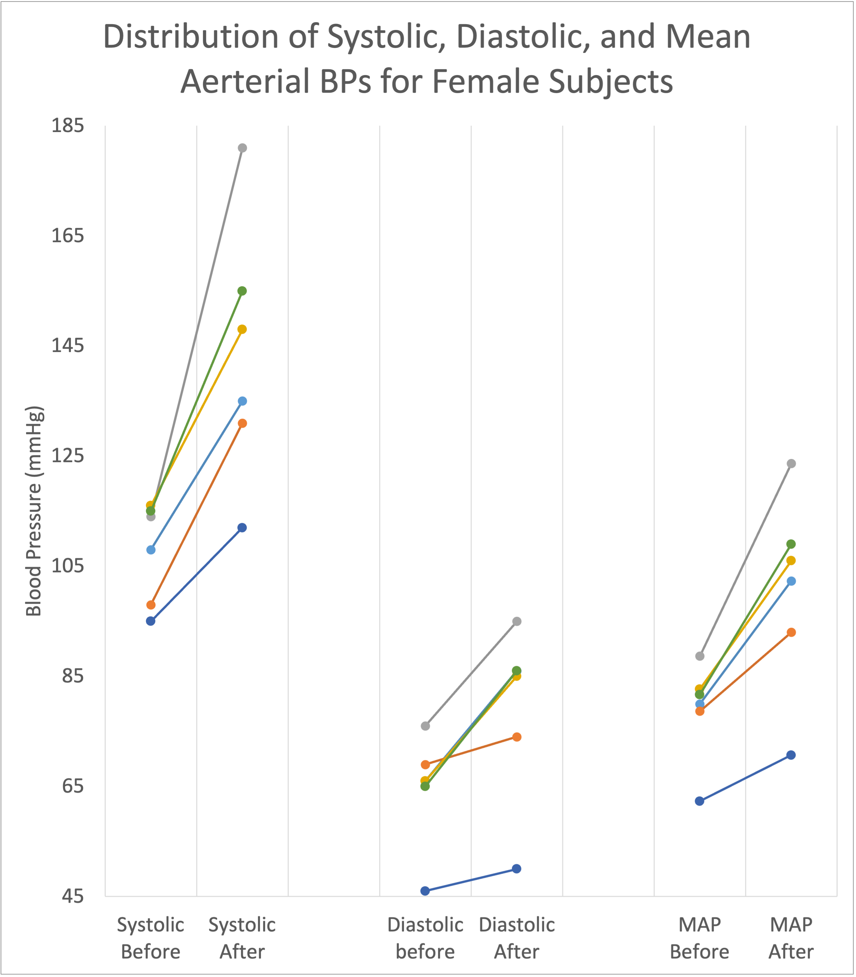
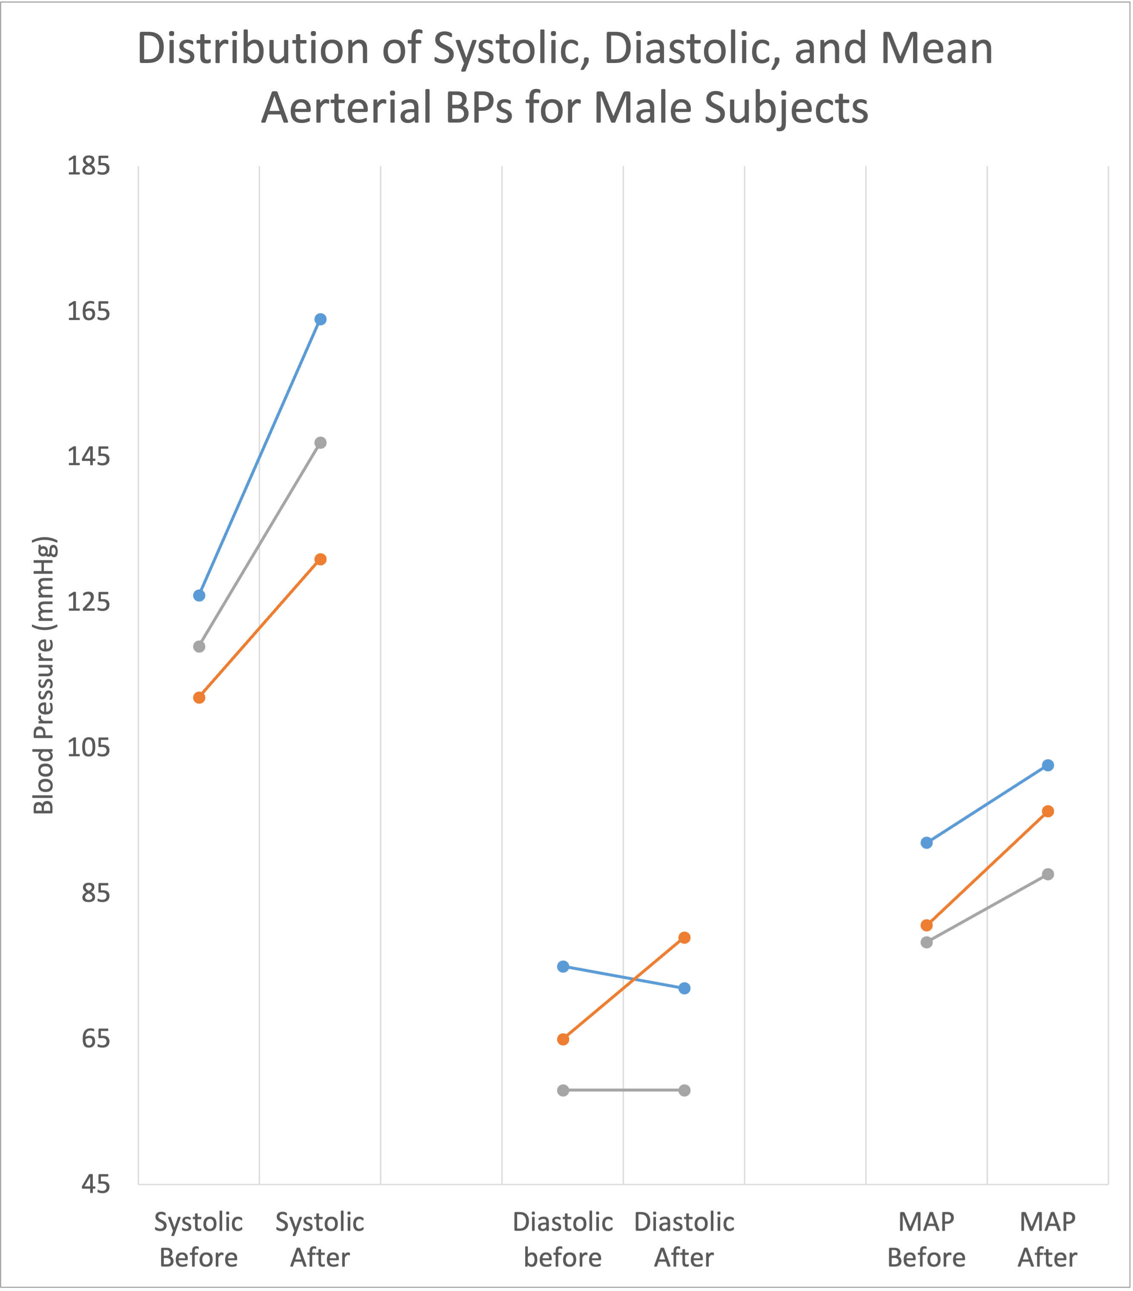

Slide 2



ANOVA tables resulting from various dependent variables (dv)
dv = MAP
dv = Systolic BP
dv = Diastolic BP

